Slide 1




Slide 2





1
Use an
Introductory Verb
2
Change Tenses
(go backwards in time)
3
Change
here to there
now to then

Slide 3
1
Introductory
Verb
She told me
(that…)
He said
(that…)
They explained (that..)
We informed her (that..)
I pointed out
(that…)
She added (that..)
He claimed (that..)
She whispered (that..)
They thought (that..)
etc

Slide 4



2
Change Tenses
(go backwards in time)
Present
Simple or Continuous
Past
Simple or Continuous
Present Perfect
Simple or Continuous
Past Perfect
Simple or Continuous
Past
Simple or Continuous
Past Perfect
Simple or Continuous
Future Simple (will + inf.)
would + inf.

Slide 5

Remember to change these
can
could
will
would
am, is, are
was, were
have, has, had
had
was, were
had been

Slide 6

DO NOT change these
V-ing
past participle
to + infinitive
bare infinitive

Slide 7



Change time and place
this, these
that, those, the
here
there
now
then
today
that day
this evening
that evening
tonight
that night

Slide 8
Change time and place
yesterday
the previous day
the day before
last week
the previous week
the week before
tomorrow
the next day
the following day
next year
the following year

Slide 9



I love reading books, especially when they have such an exciting plot as this one.
Aunt Molly said ____________________ books
especially when ____________ such an
exciting plot as ____________.
she loved reading
they had
that one
a
that loved read
b
they have
that she loves reading
they had
she loved reading
we had
c
this one
that one
the one

Slide 10

We could have a look at this photo album. It’s got all the photos Lucy took on her holiday.
Brian said __________________ a look at
______ photo album and explained
____________ all the photos Lucy _________ on her holiday.
we could have
the
that it had
had taken
a
b
they could had
the
we could have
this
that they can have
these
c
d
it has
taked
they had got
had taken
that it had
has taken

Slide 11
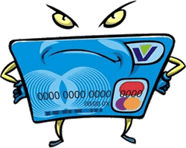
Mary used dad’s credit card to buy clothes and I don’t think dad will be very happy.
Ellie informed her mum that Mary ________________________ credit card _________ clothes and ________________
he ______________ very happy.
had used their dad’s
to buy
she didn’t think
would be
a
had used their dad’s
b
to buy
used dad’s
to bought
had been used the dad’s
bought
c
d
she didn’t thought
was
she didn’t think
would be
she hadn’t thought
would was

Slide 12
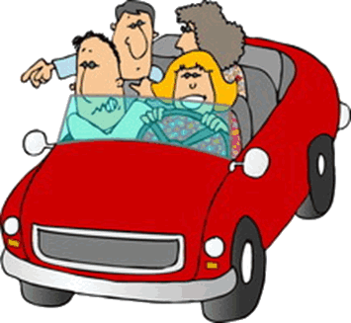
I’m getting good at driving. Actually, I think
I’m going to be an excellent driver!
Tina claimed that __________________ good at _____________ and that , actually,
______________ _____________________ an excellent driver.
she was getting
driving
she thought
she was going to be
a
b
Tina got
driving
she was getting
drove
that she had been getting
driven
c
d
she ‘s going to was
she’s thinking
I thought
she was going to be
she thought
I’m going to being

Slide 13


We didn’t do our history class today so we had a free period.
Mona explained that __________________ ________ histrory class ___________ , so __________________ a free period.
they hadn’t done
their
that day
they ‘d had
a
b
they didn’t do
their
they didn’t
our
they hadn’t done
theirs
c
d
they had
that day
the day before
they’d had
the next day
they would have

