Slide 1
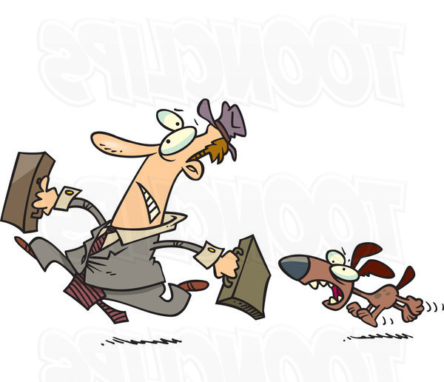
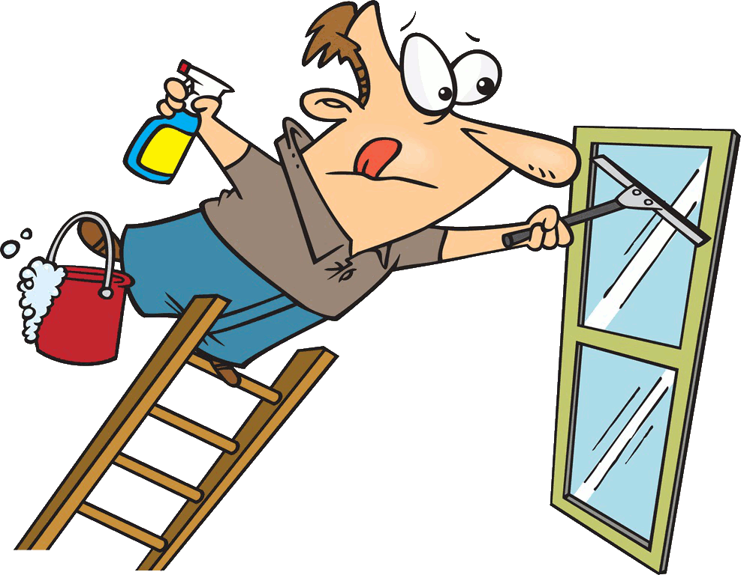
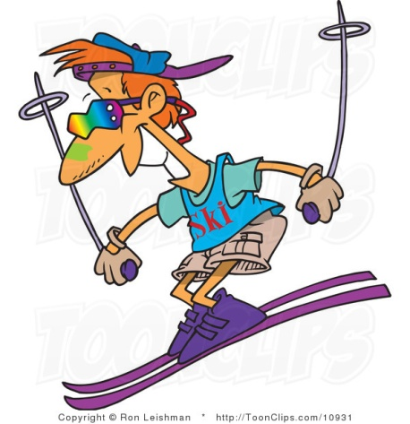
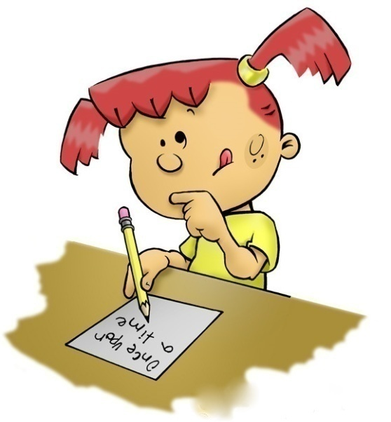
Reported speech

Slide 2

likes
liked
was liking
“I like singing songs
for my friends”
liked
Greg said that he _____
singing songs for his friends.
next

Slide 3

is
had been
was
“I am so angry today”
was
Mark said that he _____ so angry that day.
next

Slide 4
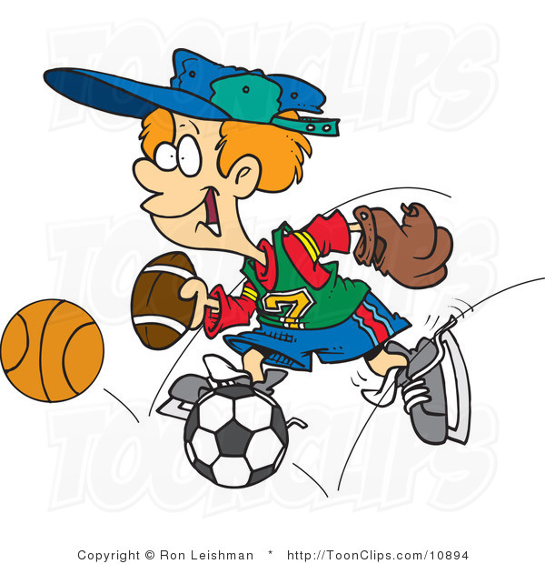
plays
played
has played
“I play football
for school team”
played
Fred said that he _____
football for school team.
next

Slide 5
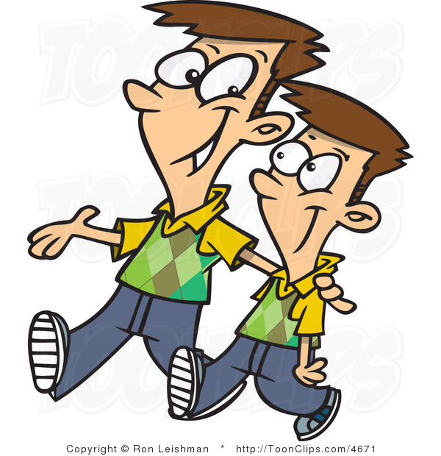
was walking
is walking
walked
“I am walking in the park with Tom”
was walking
Peter said that he ________ in the park with Tom.
next

Slide 6

was
likes
liked
“I like skiing in winter”
liked
Samuel said that he _____
skiing in winter.
next

Slide 7

played
had played
was playing
“I played computer games yesterday”
Andrew said that he__________ computer games the day before.
had played
next

Slide 8
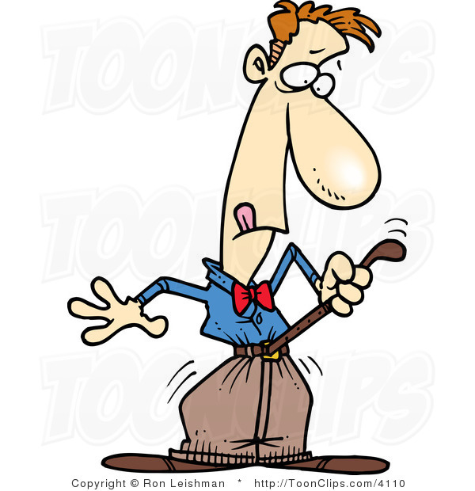
was
is
were
“I am so slim”
was
Tom said that he ____
so slim.
next

Slide 9
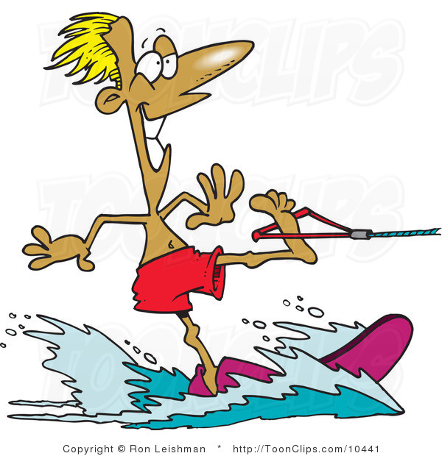
had gone
gone
was going
“I went to the seaside last summer”
had gone
David said that he _______
to the seaside the previous summer.
next

Slide 10
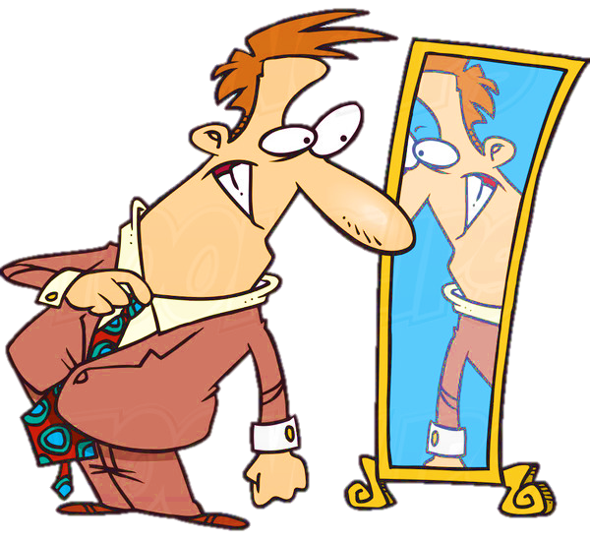
would buy
could buy
buy
“I will buy a new suit in two weeks”
would buy
Jack said that he ________
a new suit two weeks after.
next

Slide 11
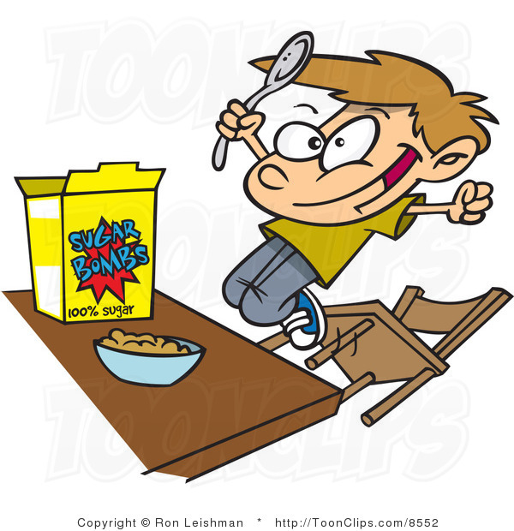
was
have been
is
“I am so hungry now!”
Mike said that he
____ hungry then.
was
next

Slide 12
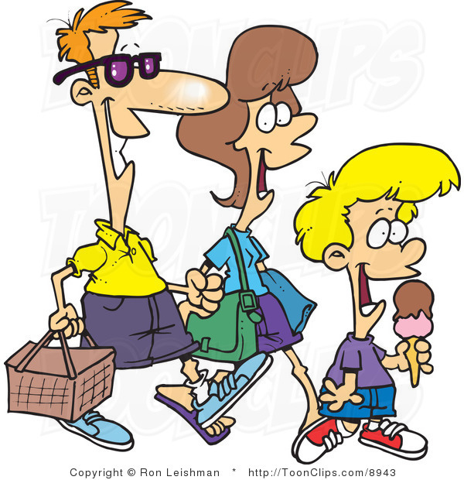
had gone
was going
would go
“We will go for a walk in four hours”
would go
Tom said that he _______
for a walk four hours after.
next

Slide 13
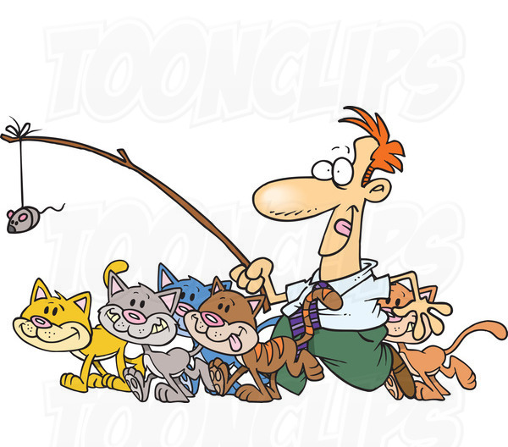
was walking
has walked
had walked
“I walked my cats last week”
had walked
Carl said that he ________
his cats the previous week.
next

Slide 14
was cleaned
had cleaned
cleaned
“I cleaned the windows two days ago”
had cleaned
Eric said that he _________
the windows two days before.
next

Slide 15
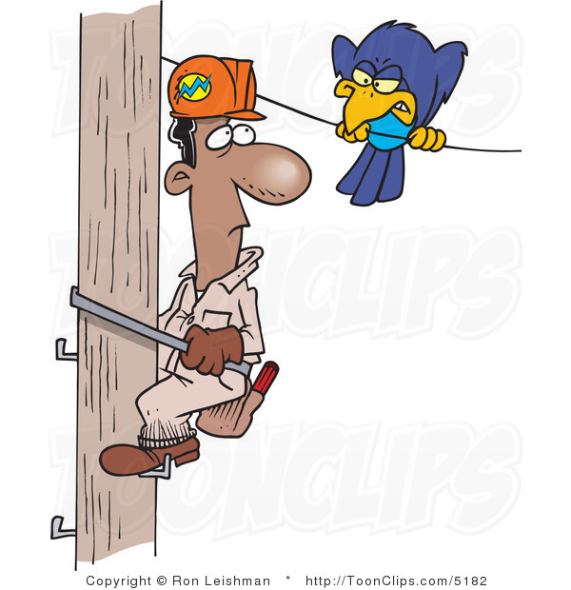
finish
has finished
would finish
“I will finish my work tomorrow”
would finish
Mason said that he _________
his work the next day.
next

Slide 16
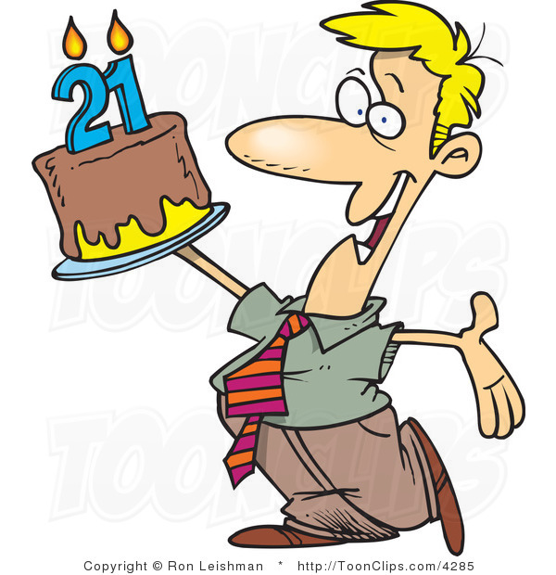
had cooked
was cooking
cooked
“ I have cooked a tasty cake”
Alan said that he
________ a tasty cake.
had cooked
next

Slide 17
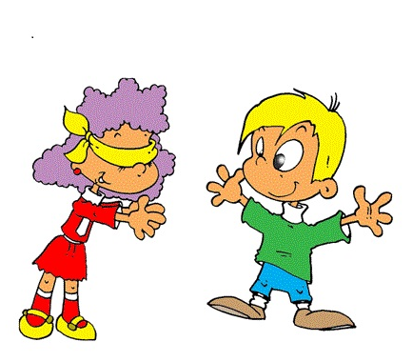
was visiting
had visited
has visited
“I visited my friend last week”
had visited
Ann said that she ________
her friend the week before.
next

Slide 18
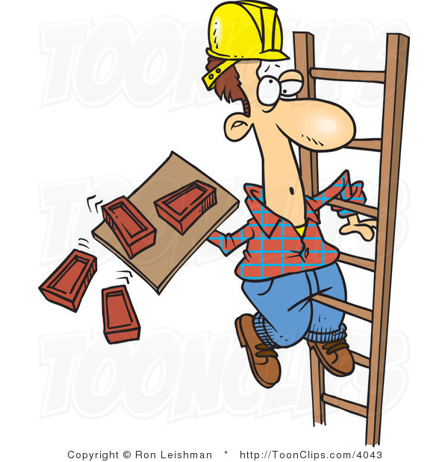
had built
was building
built
“We have built the house!”
had built
Jason said that they _______
the house.
next

Slide 19
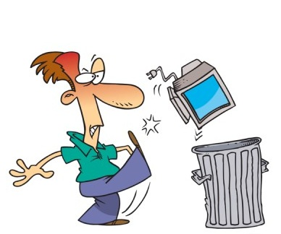
took
was taking
had taken
“I am taking the rubbish out ”
Diego said that he
________the rubbish out.
was taking
next

Slide 20

would send
will send
had sent
“I will send a letter tomorrow”
would send
Susan said that she ________
a letter the next day.
next

Slide 21
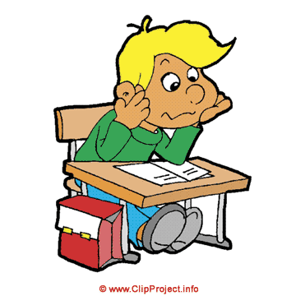
did
does
was doing
“I always do my homework”
John said that he always ____ his homework.
did
next

Slide 22
The end

